Slide 1
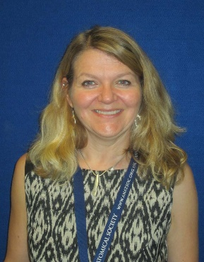



Dr Debra Patten
Director of Anatomy and Clinical Skills
School of Medical Education
School of Medicine, Dentistry & Biomedical Sciences
Centre for Biomedical Sciences Education
‘Ultrasound in the undergraduate medical curriculum in the UK: where are we at and where are we going next?’
Tuesday, 20th March 2018,
1.00 – 2.00 pm
Venue: Basement Seminar Room, Centre for Cancer Research and Cell Biology (CCRCB)
Sponsors:

